Slide 1
Hybridizing MDBs

Slide 2
Homage to Ben Hager
Ben realized that the SDB X pumila MDBs were nearly sterile dead ends so wanted to create a stable 40 chromosome line.
Crossing tet MTBs with pumila gave fertile MDBs.
These hybrids had dwarfing influences from pumila, aphylla and the BBs that contained variegata blood.
Crossing these Hager MDBs with those that are fallouts from the SDB lines allows full segregation of characters and allows improvements from SDB breeding to be incorporated into the MDBs.

Slide 3
Vaughn plan
Cross Hager line MDBs with best of the SDB fallouts and then line and cross breed these.

Slide 4
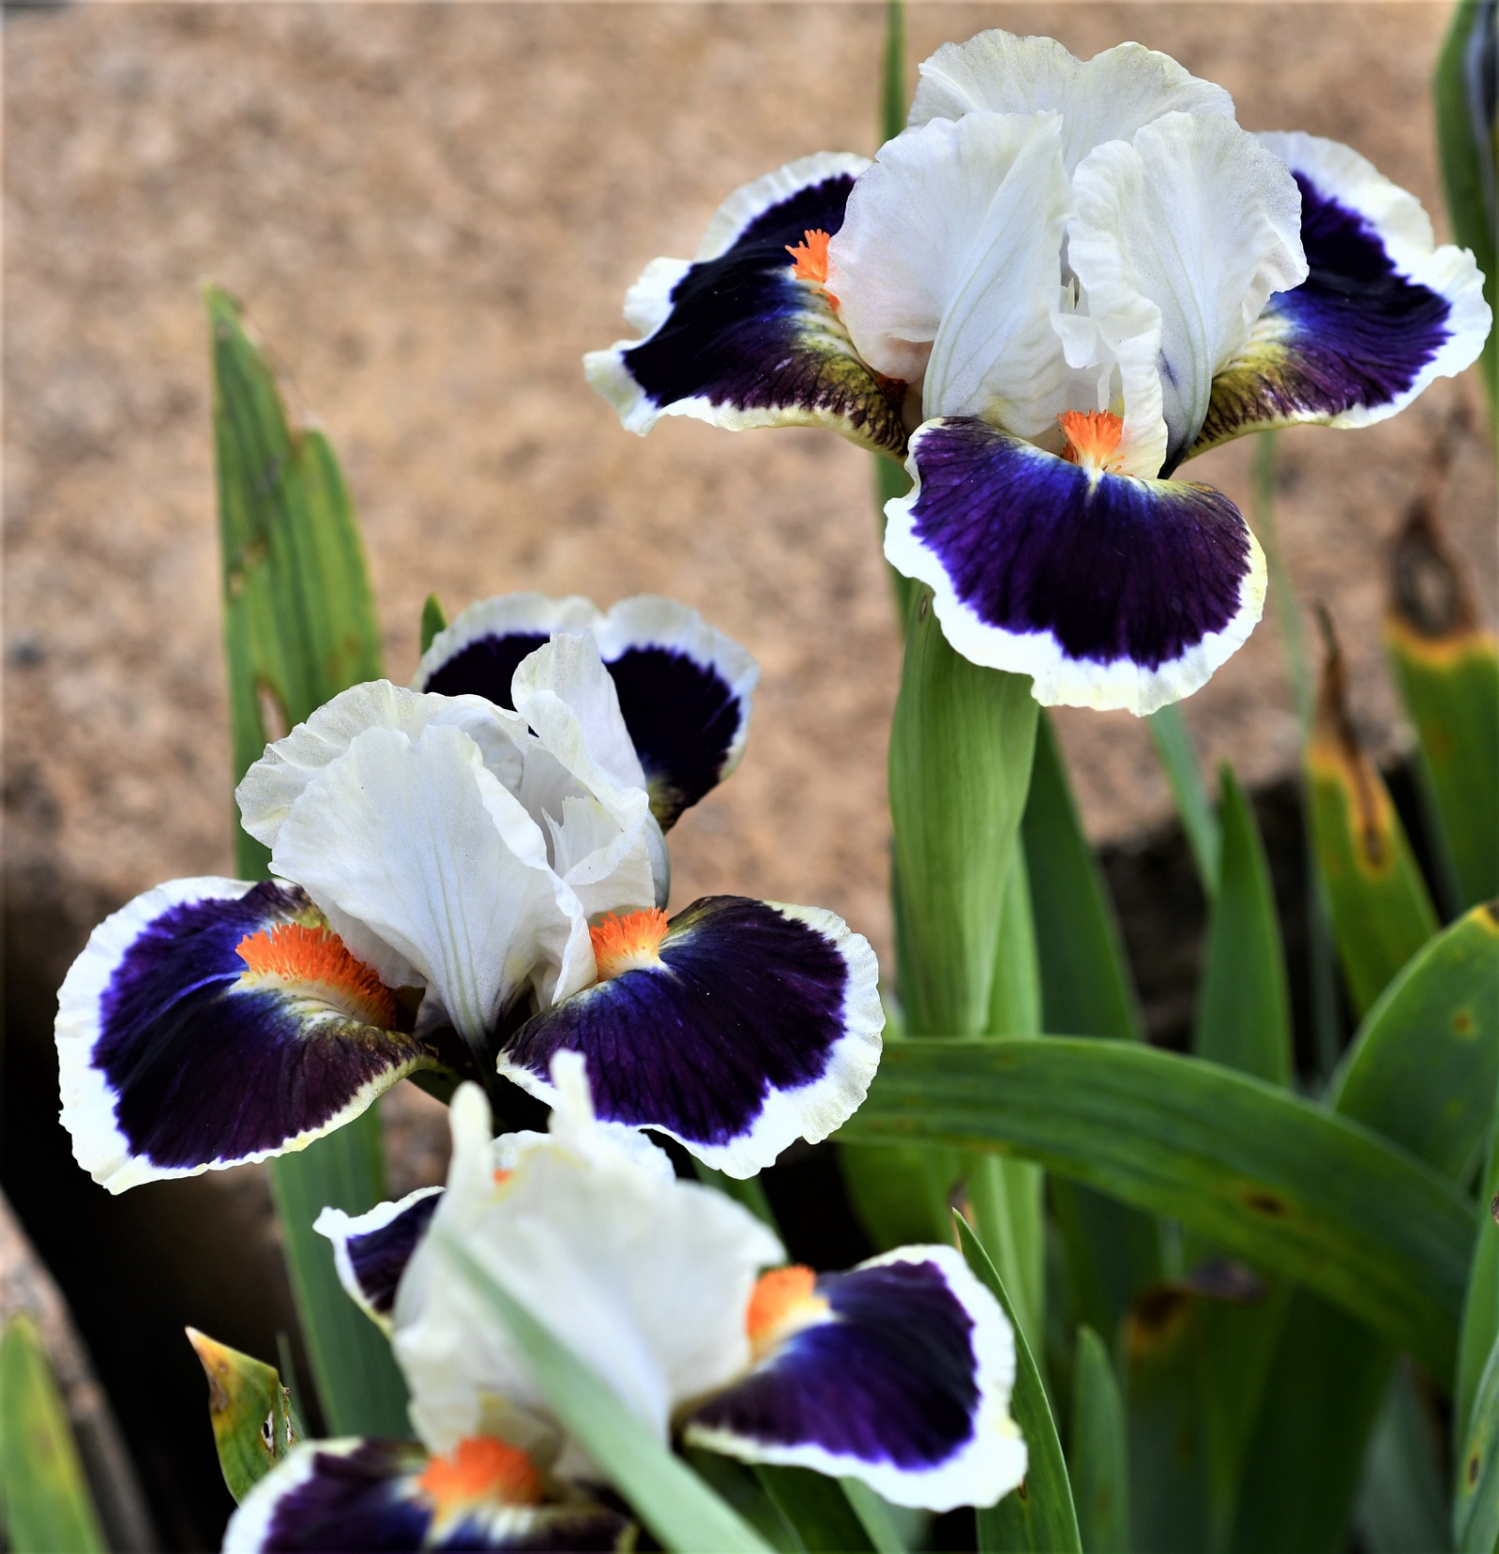

Slide 5
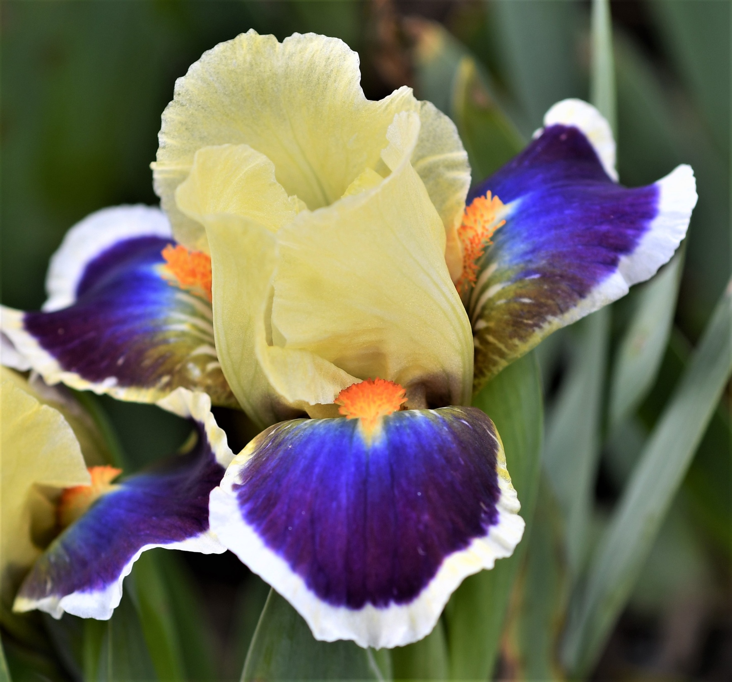

Slide 6
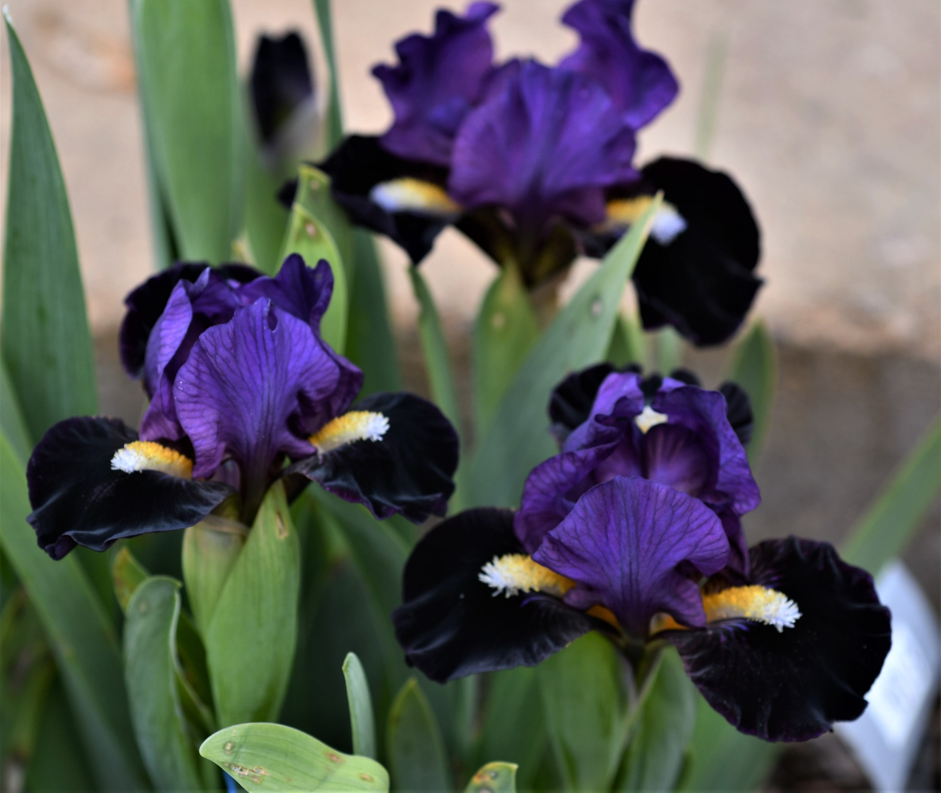

Slide 7
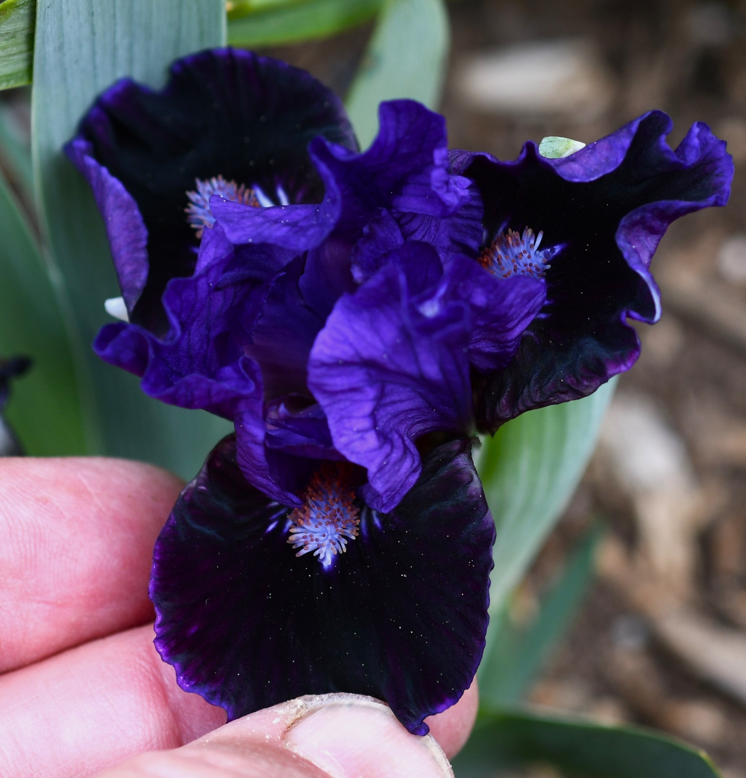

Slide 8
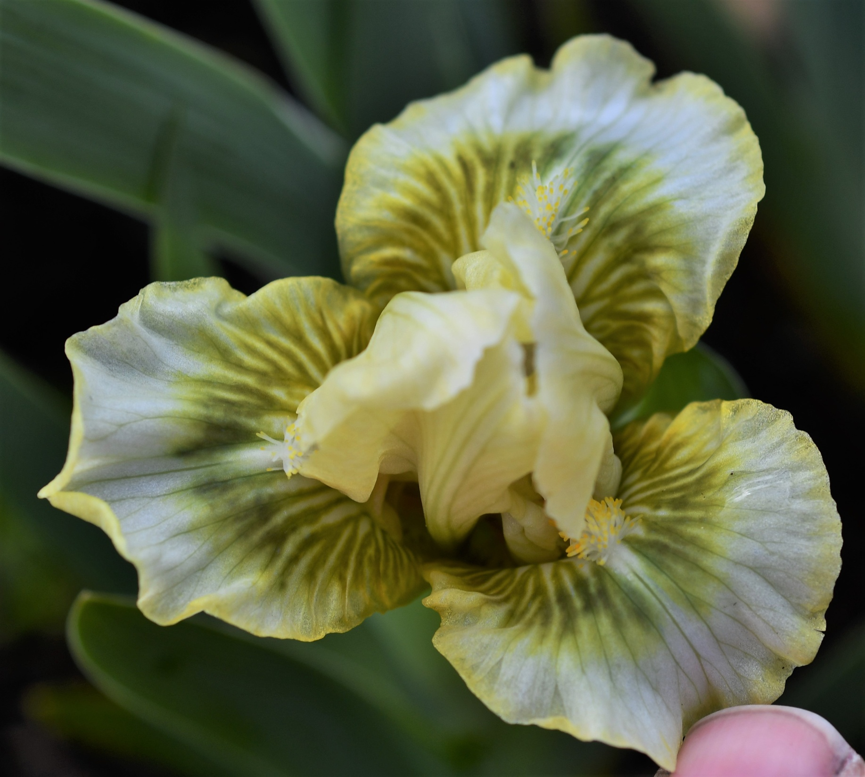

Slide 9
(Twinkle Little Star X Ribbit)
Over 100 seedlings of listed cross and reciprocal.
Random mating of F1 seedlings resulted in very large variety of sizes, colors and patterns.
Several F1’s are selected for introduction!

Slide 10
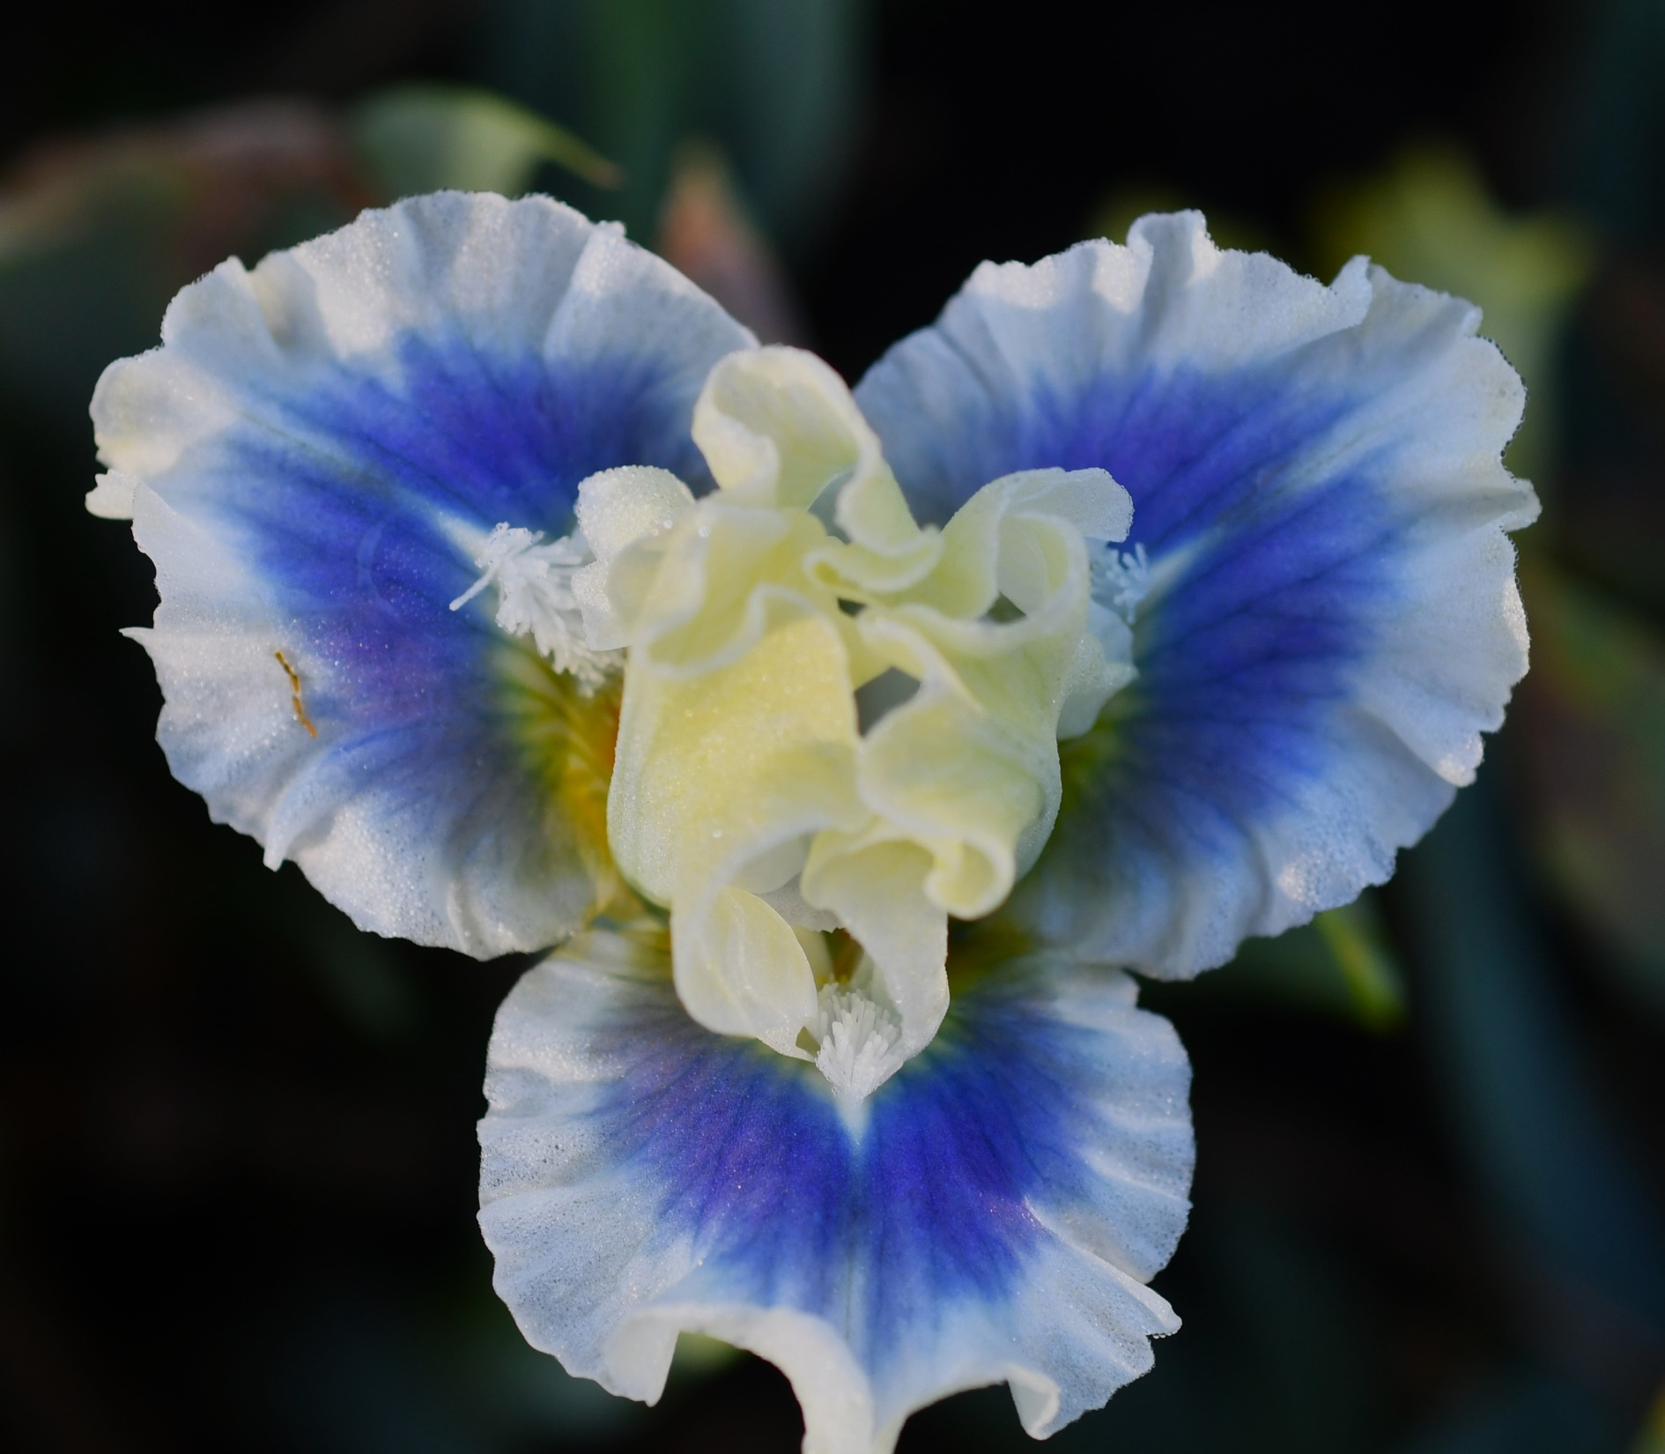

Slide 11
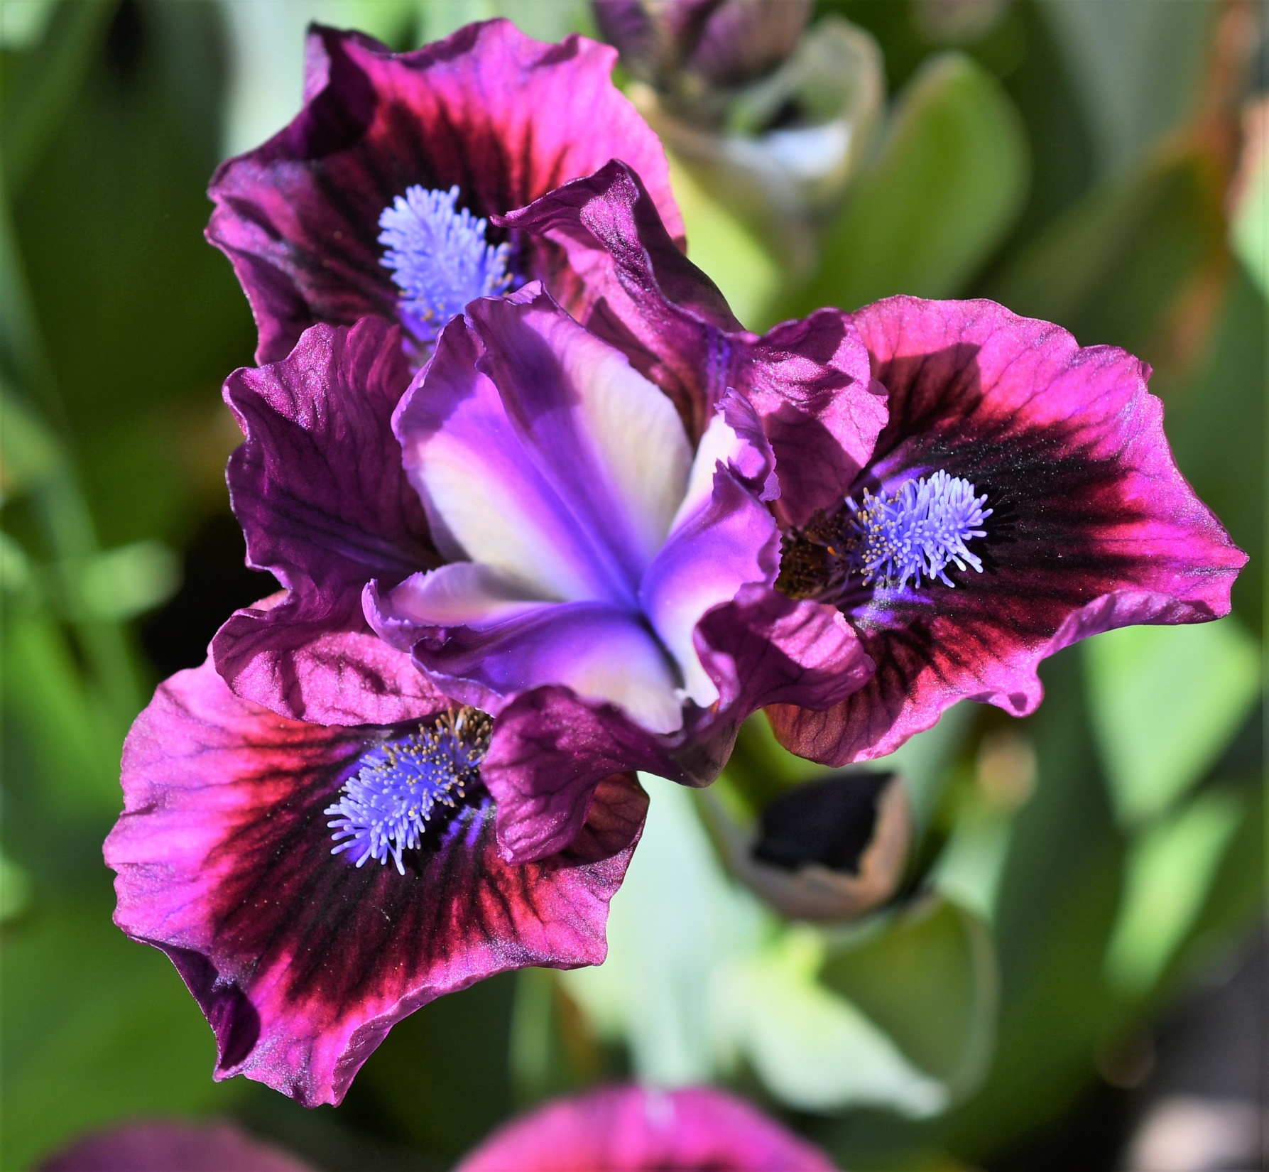

Slide 12
Nature of Amphidiploids
SDBs and most MDBs are amphidiploids, with two sets of TB chromosomes and two sets of pumila chromosomes.
4 chromosomes are homologous enough to pair. This should allow for genes for pumila to end up on TB chromosomes and vice versa.
(Searing Embers X Debonair Bear) segregated both tall SDBs and 4-5” MDBs.

Slide 13
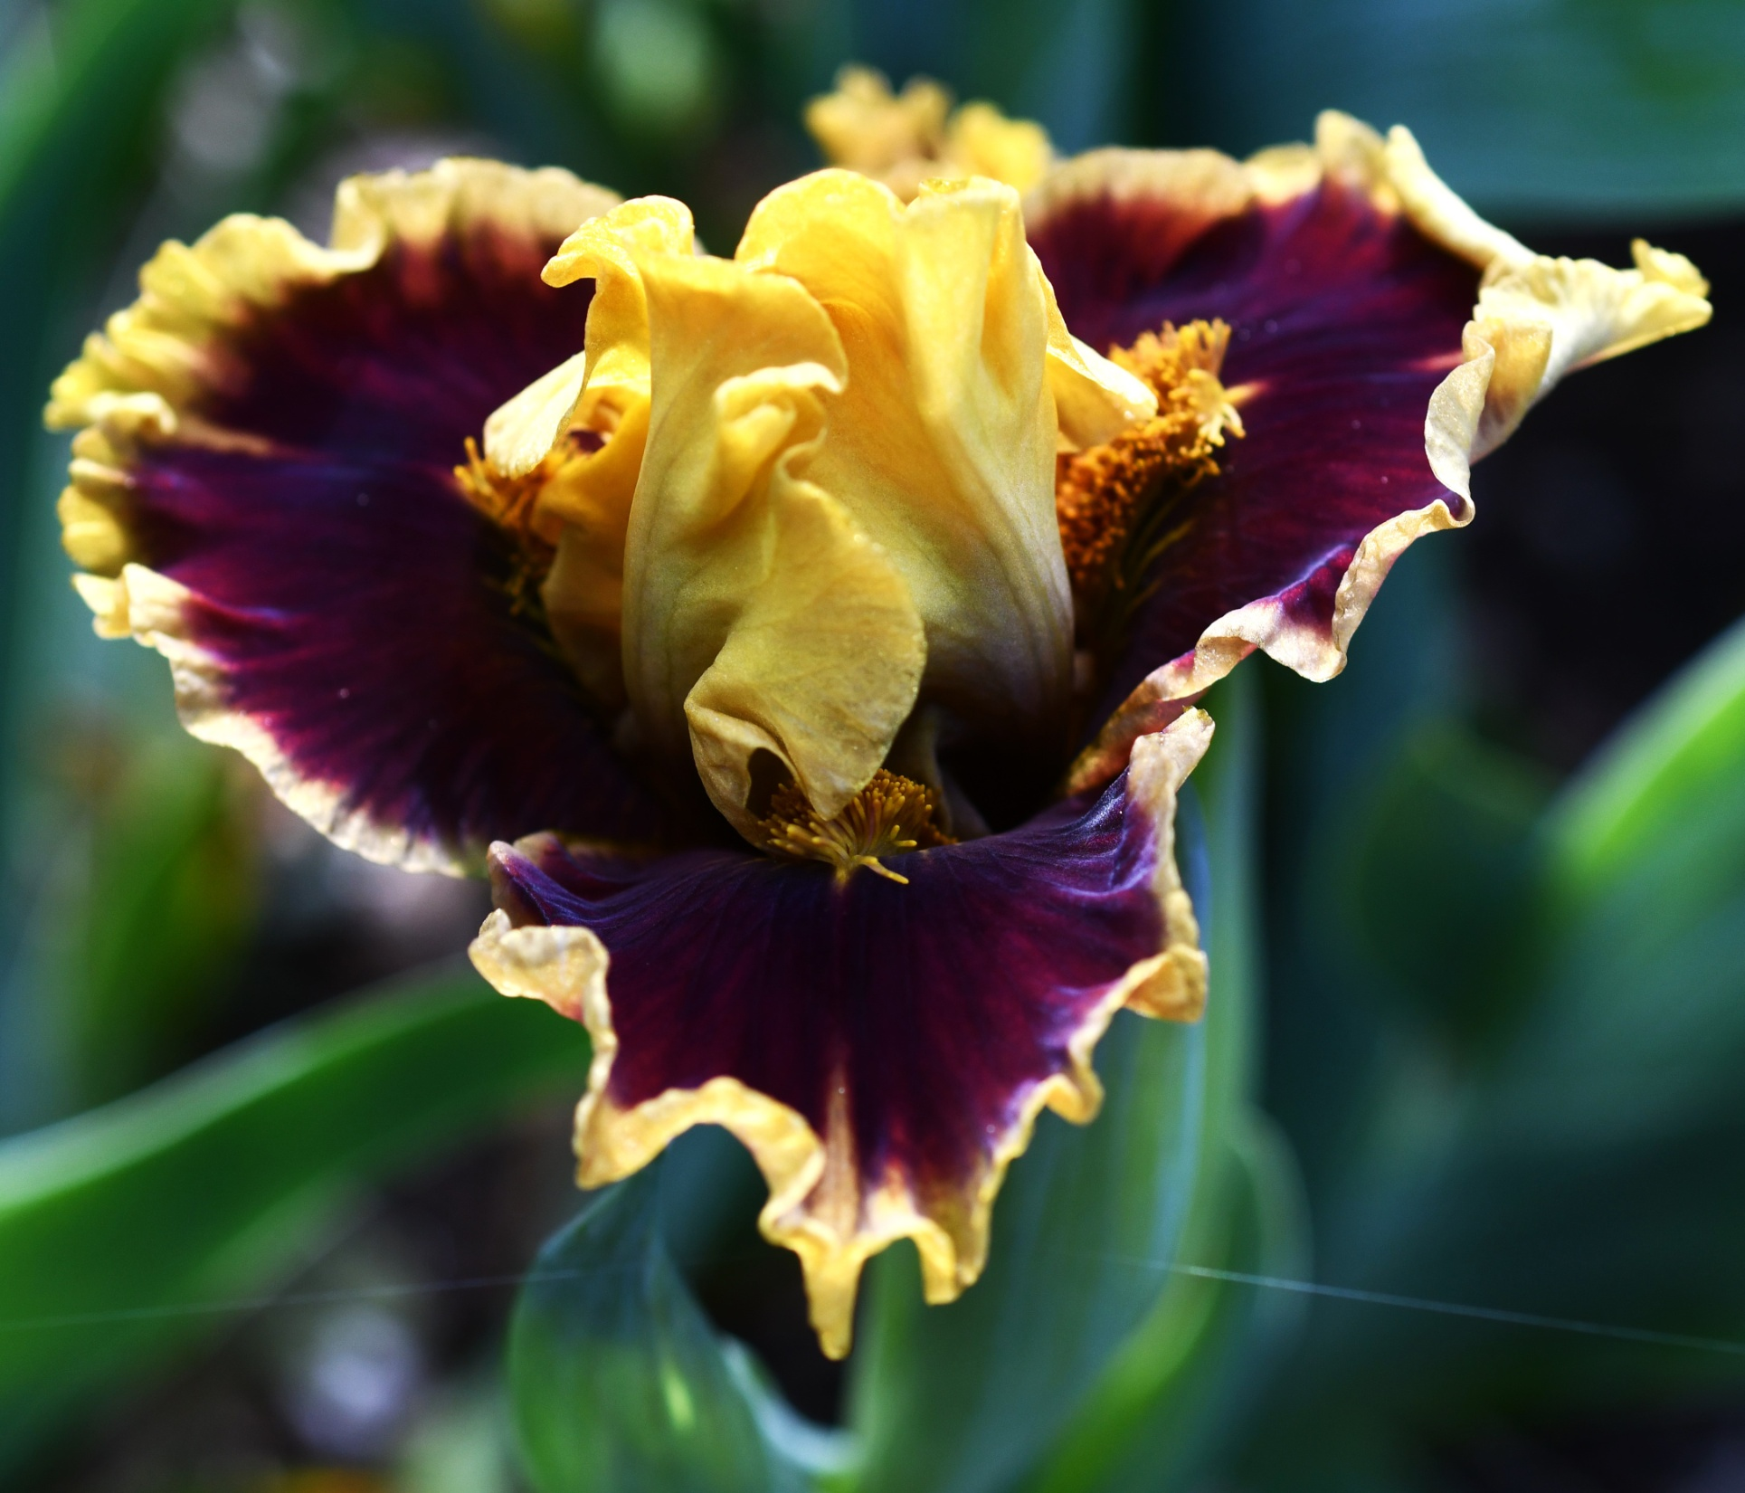

Slide 14
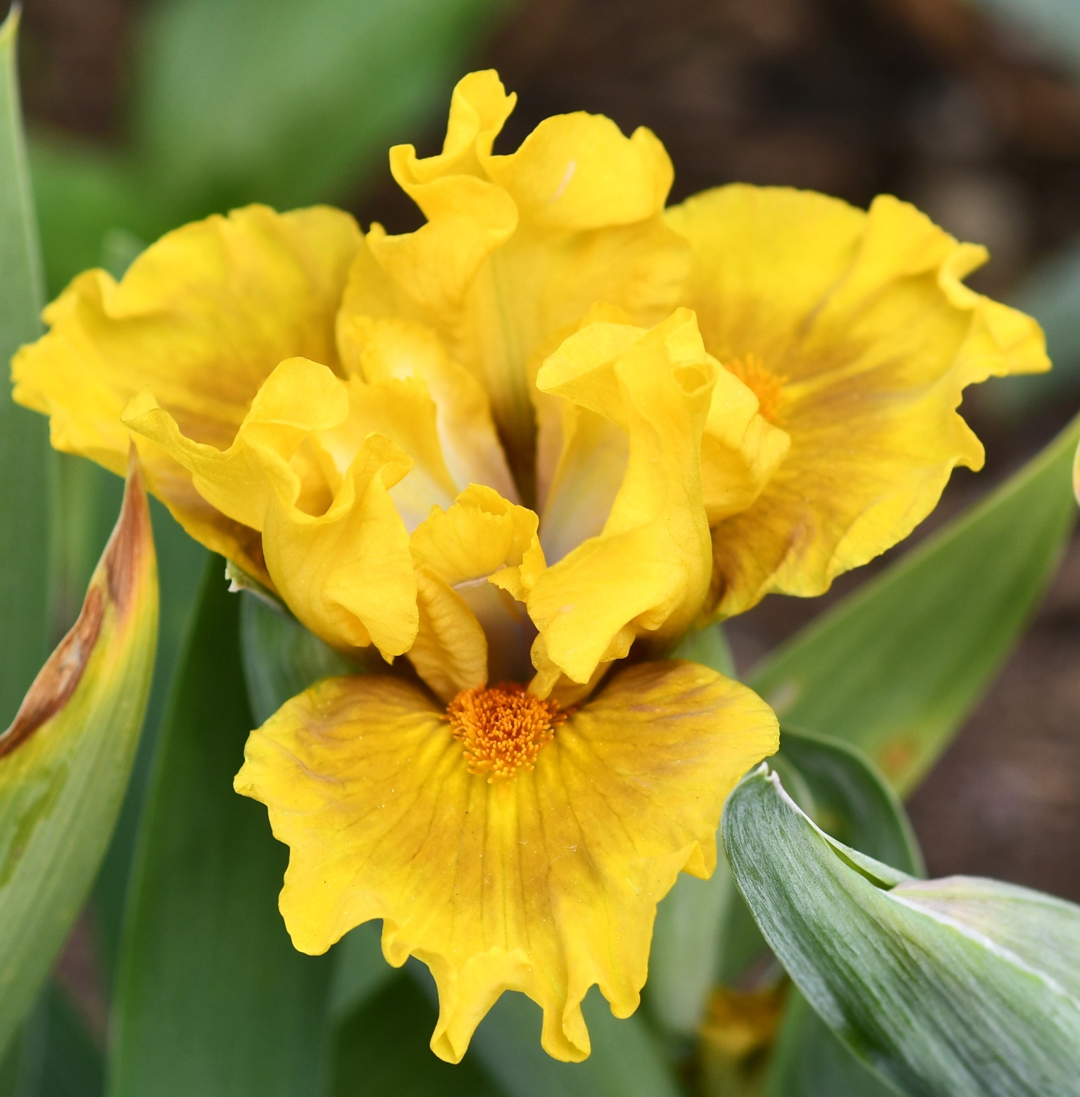

Slide 15
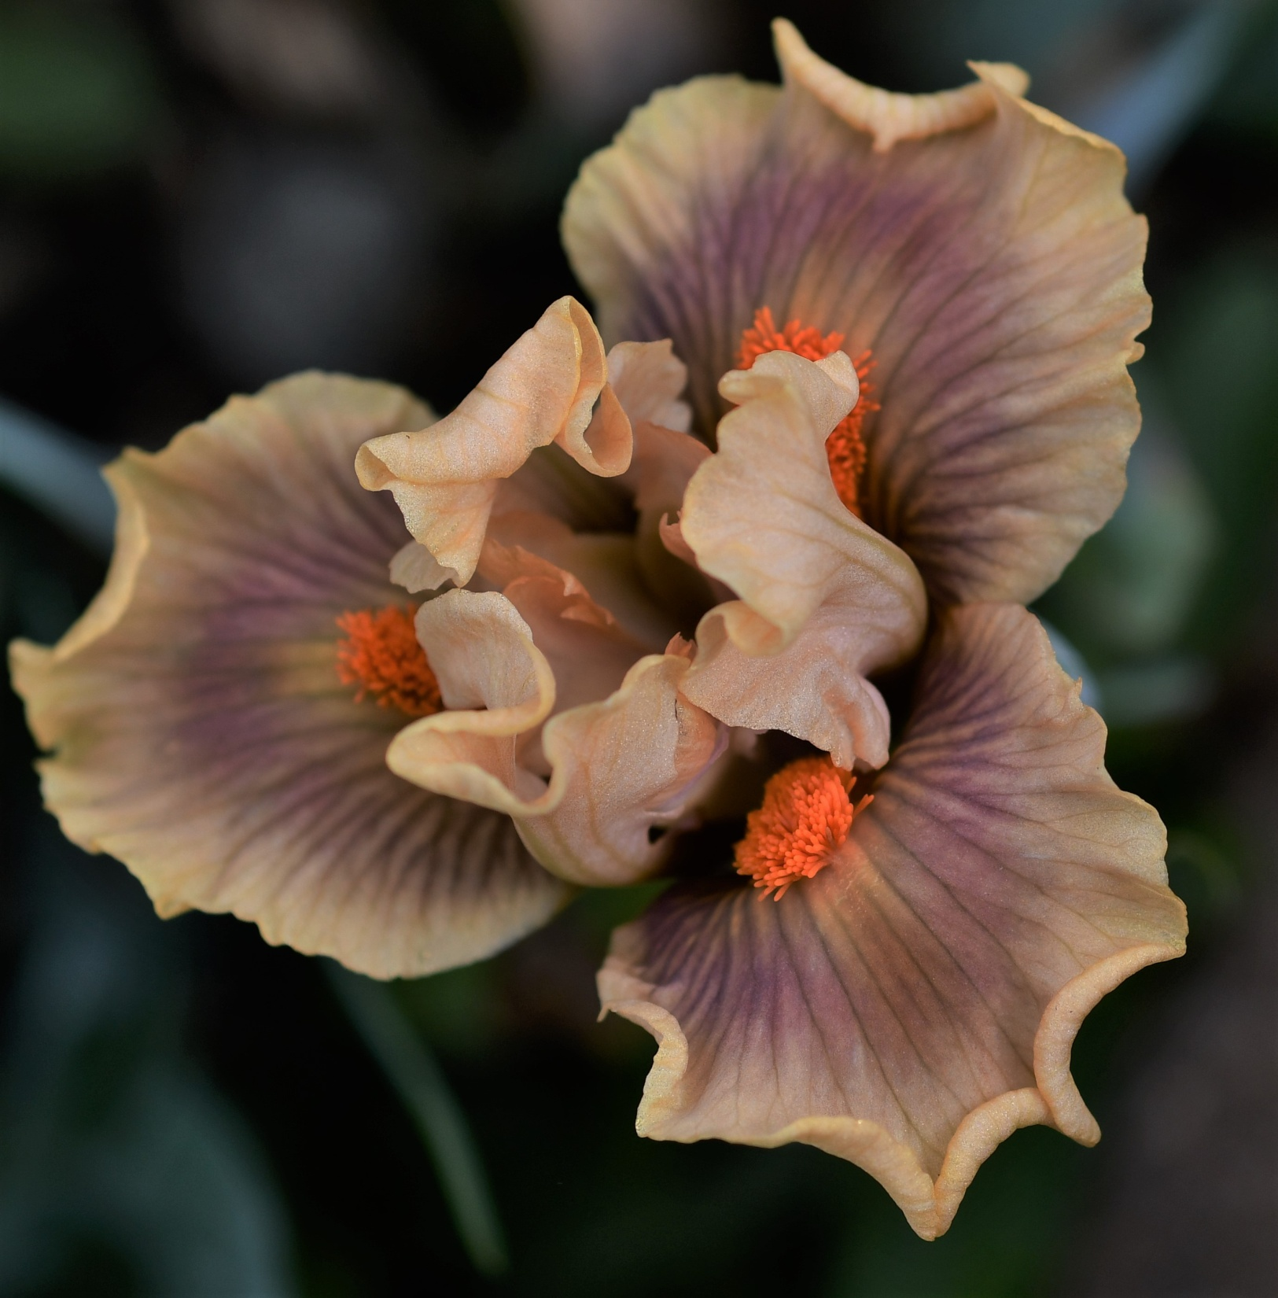

Slide 16
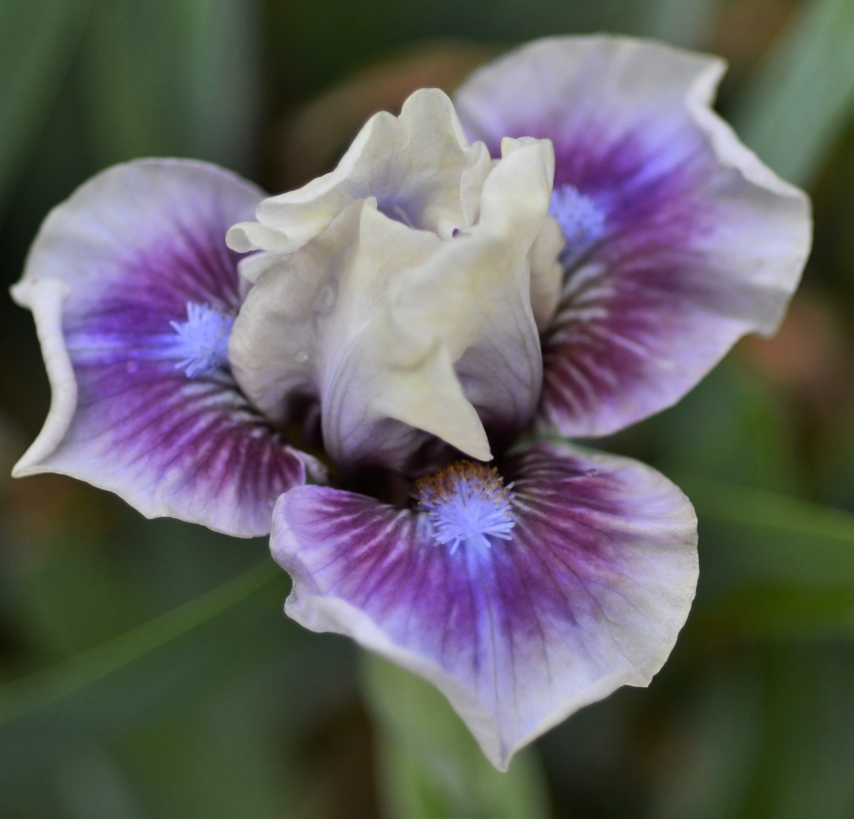

Slide 17
The Future
Using the Hager MDBs from (tet MTB X pumila) crosses with those derived from short SDB breeding is leading to MDBs with improved form and exciting colors.
Because of their fertility, line breeding and outcrosses may be used to refine and embellish these flowers.
Some evidence is shown for crossing over between TB and pumila crosses. Those TB chromosomes with pumila genes may be especially useful in producing MDBs.

